Slide 1
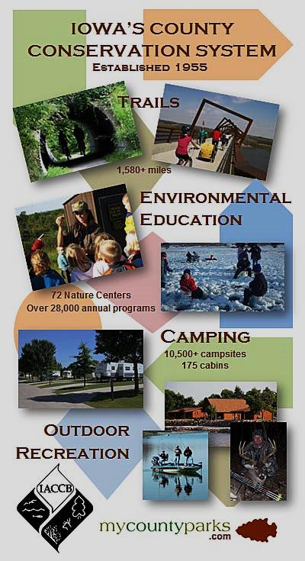
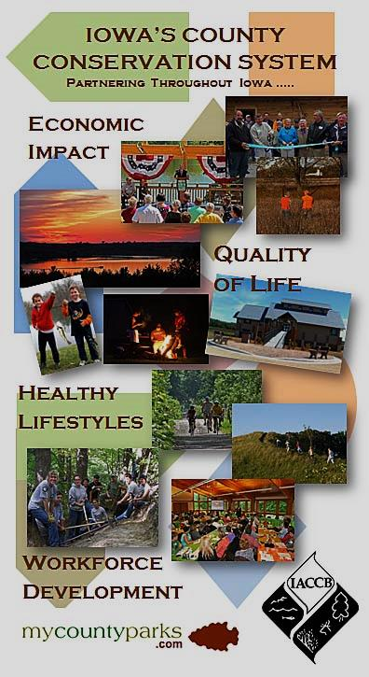
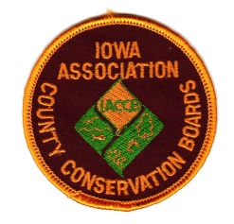
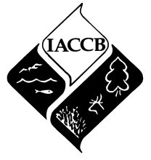
Telling your story ….
Selling your program!
2014
Prepared for Winterfest 2014 by Thomas F. Hazelton, CEO Iowa’s County Conservation System

Slide 2
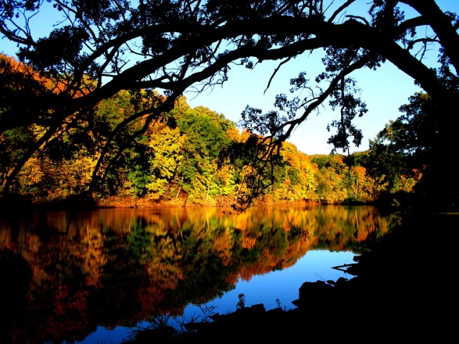
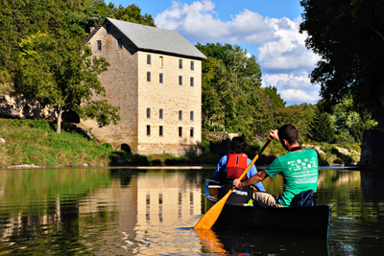
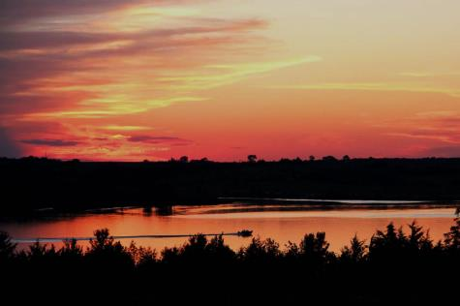
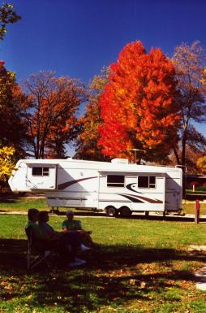
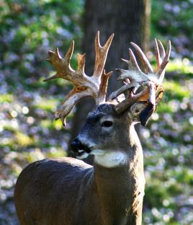
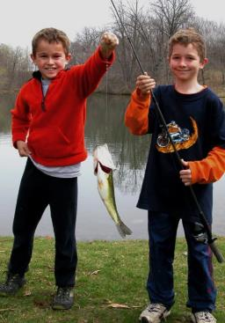
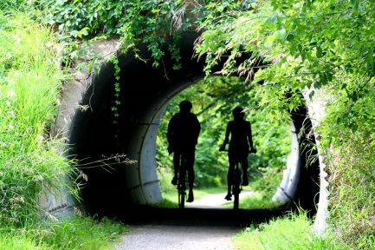
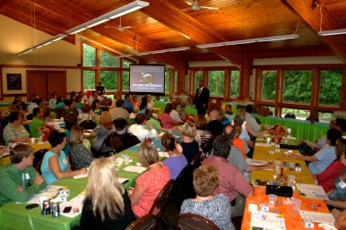
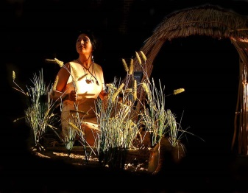
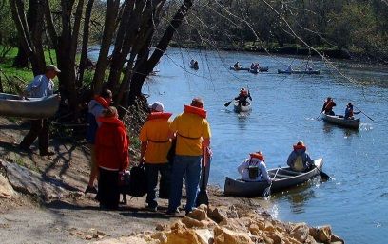
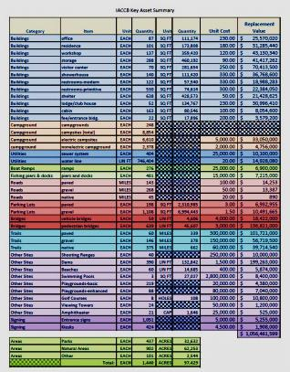
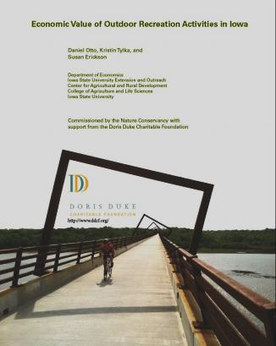
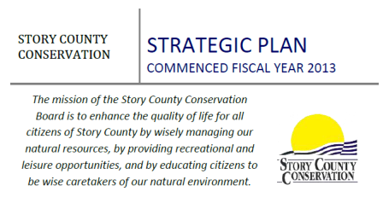
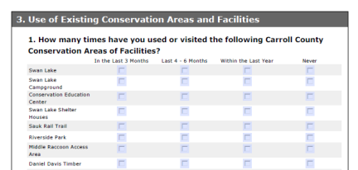
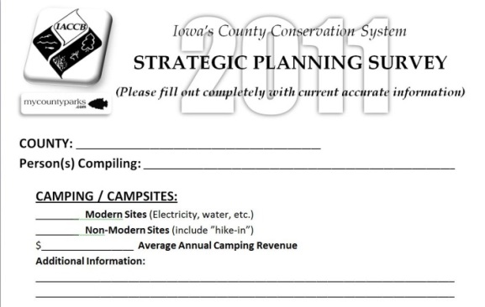
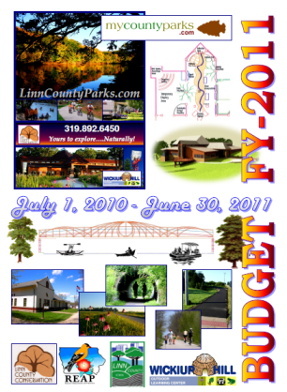
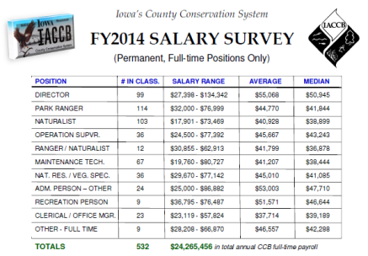
#1. You have GOT to have the pictures!
#2. Got facts?

Slide 3
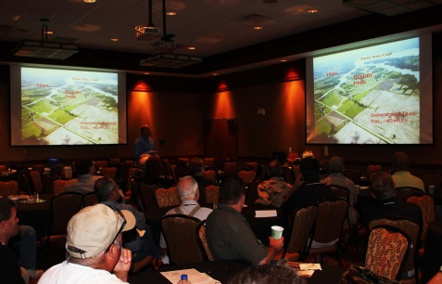
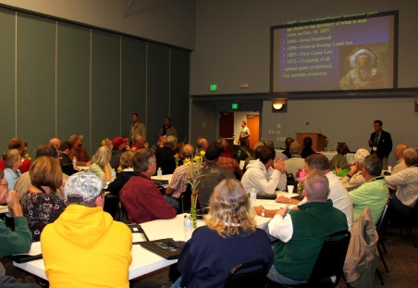
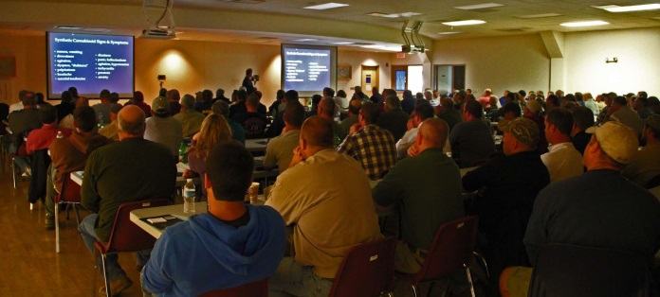
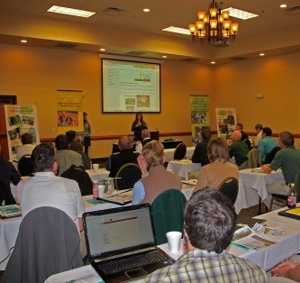
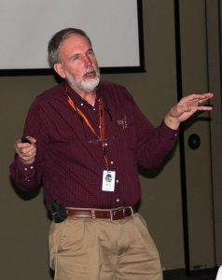
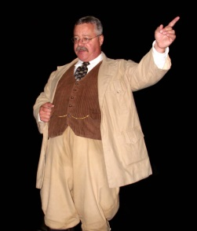
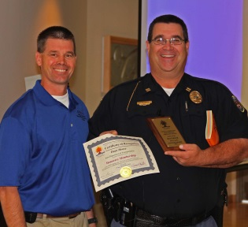
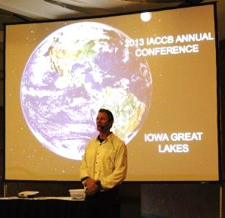
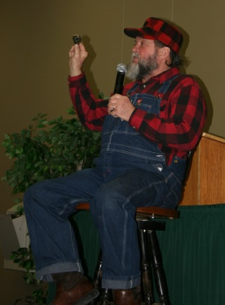
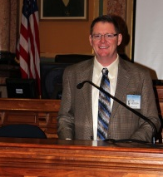
#3. Tell it with PowerPoint.
#4. Tell it with PASSION!
#5. Tell it OFTEN!
On with the story……

Slide 4
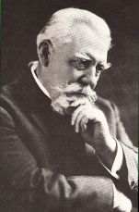
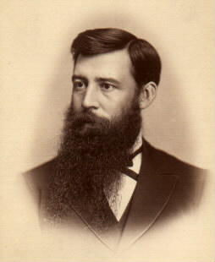
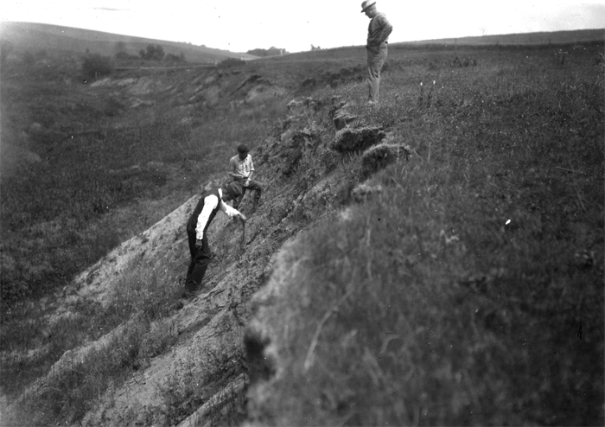
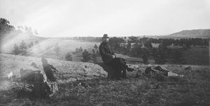
Thomas H. MacBride - 1896
10th President of the University of Iowa, 1914-1916
“It is my purpose here to show that such parks are needed, that they are needed now; that they should have the highest scientific value, and that in Iowa they are everywhere practicable.”
“The necessity for such parks in Iowa seems to me to be threefold:
1st As directly affecting public health & happiness.
2nd For proper education
3rd To preserve to other times and men something of primeval nature.”

Slide 5
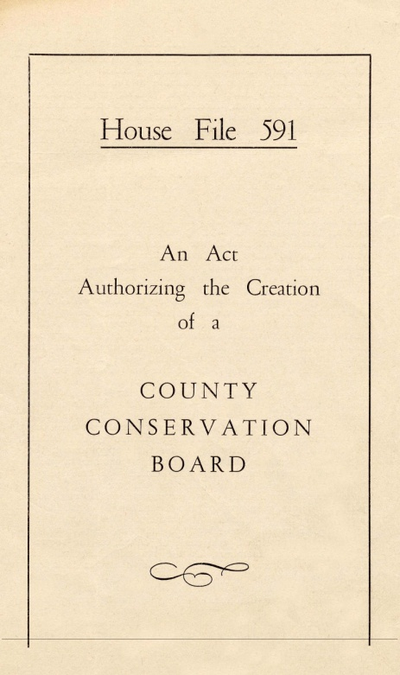
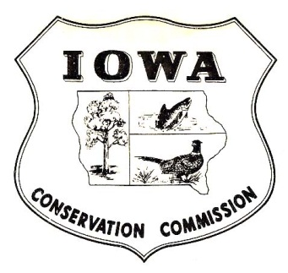
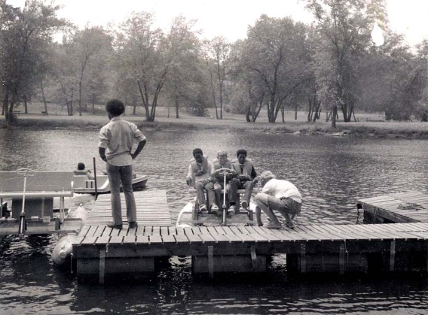
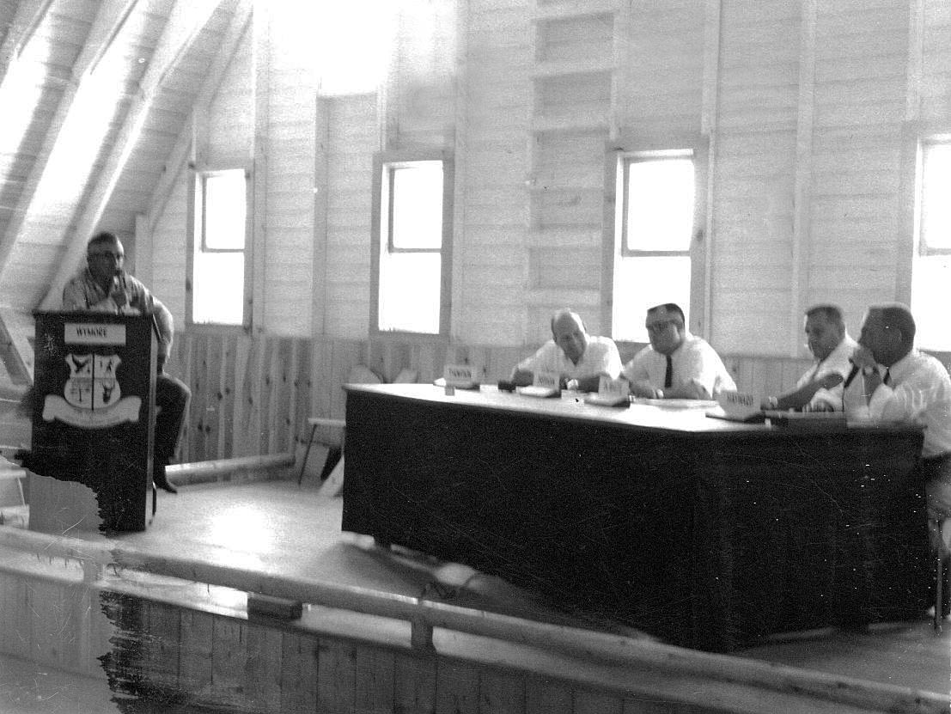
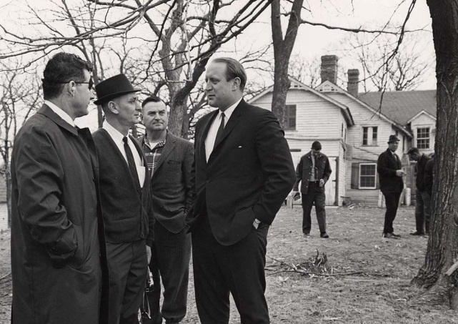
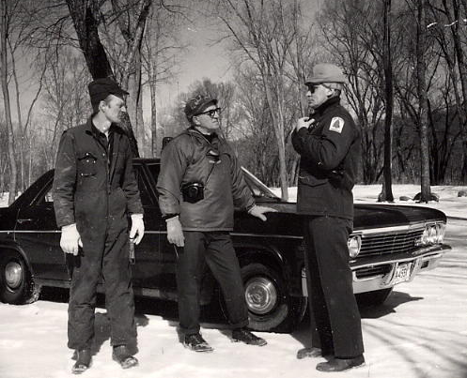
1955 - CHAPTER 350
1958 – The Iowa Conservation Commission (DNR) established the “County Conservation Activities Office”
Office was closed in 1989
1959 – Iowa Association of County Conservation Boards

Slide 6
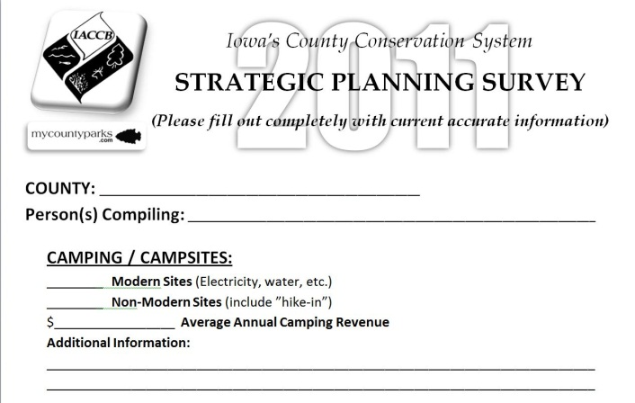
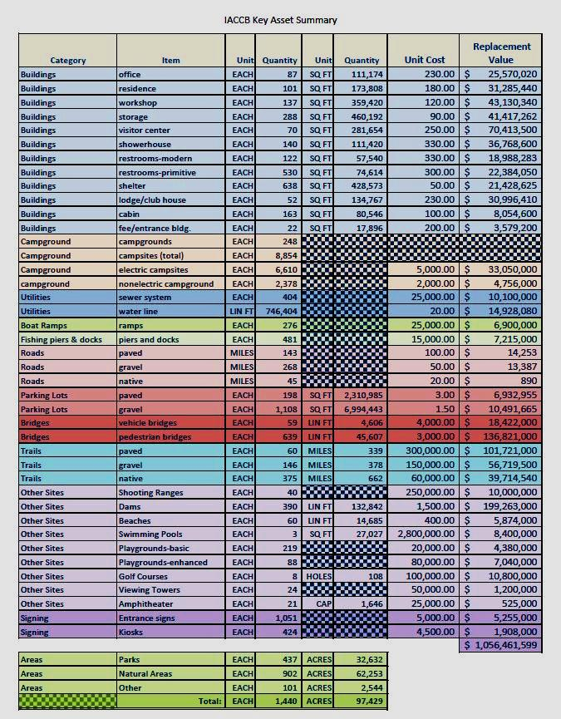
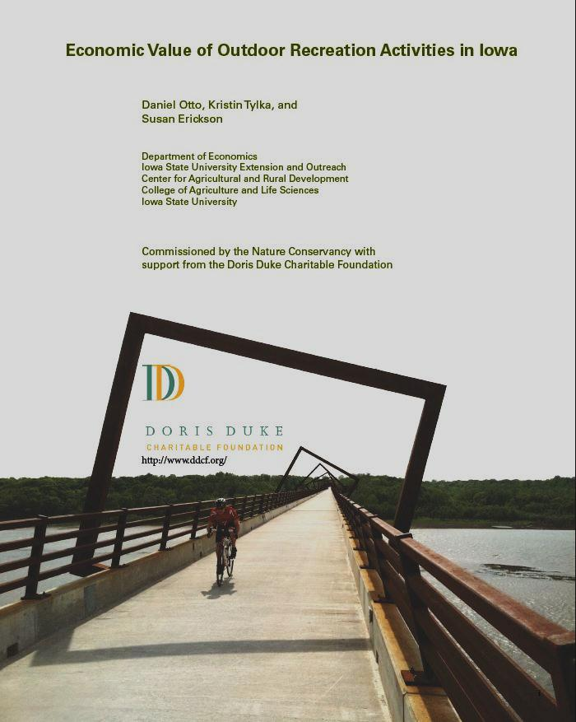
2011 IACCB Strategic Planning Survey of all 99 counties
2012 County Conservation Asset Inventory Survey
2012 ISU Study on the Economic Value of Outdoor Recreation Activities in Iowa
Resources for the Statistics that Follow

Slide 7
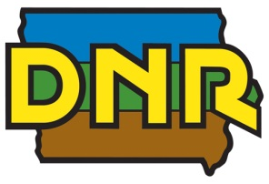
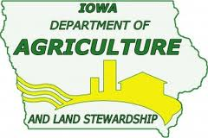
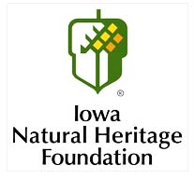
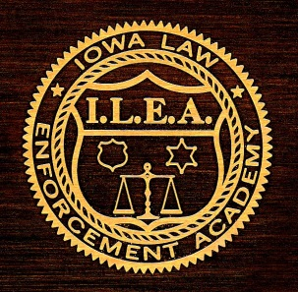
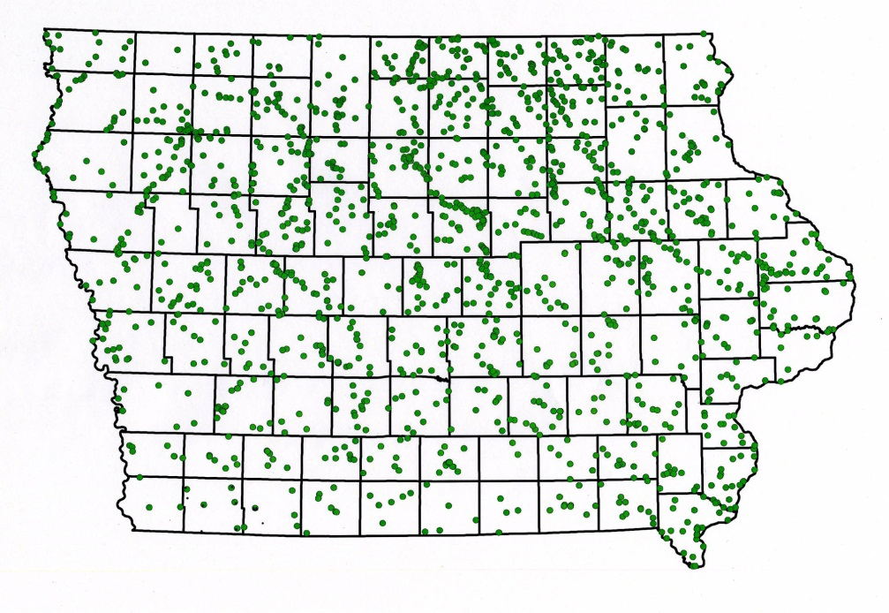
Iowa’s 99 county conservation boards were formed by majority votes of people in each county from
1956 thru 1989
1,832 areas
Liaisons & Partnerships
The winning formula(s)?
Local control
Local funding & support
Local ownership
Local partnerships/people

Slide 8
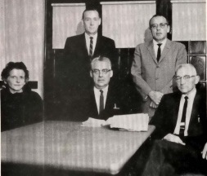
The People …..
495 Conservation Board Members (5 appointed by B.O.S. in each county)
99 Conservation Directors (1 hired by each County Conservation Board)
475 General Employees (hired by Directors & Conservation Boards)
1,069 Dedicated People *
* PLUS - 350+ part-time & seasonal staff, and thousands of volunteers

Slide 9
2014
697 years
32 Employees
Average of 21.78 years (High of 48, low of 1)

Slide 10
Internal Associations
IACCB – Iowa Association of County Conservation Boards 594 members
IACCBE – Iowa Association of County Conservation Board Employees 574 members
CCDA
CCDA – County Conservation Directors Association – 99 members
IAN – Iowa Association Naturalists 150 members
CCPOA – County Conservation Peace Officers Association 160 members
AFIRM – Association for Integrated Roadside Managers 50 members

Slide 11
Iowa’s County Conservation System – The FACTS
THE PEOPLE: - 495 Board Members - 99 Directors - 475 Employees 1,069 great people
1,536+ miles of trails
THE PLACES: - 193,624+ acres - 1,832 parks, natural areas, preserves, historic sites, trails & more!
70 Education Centers (3 more under construction)
10,507 campsites
175 cabins in 48 counties
25,840 programs & events
752,700 participants

Slide 12
Arrived on Internet in 2006 Expanded statewide in 2009 FREE to all counties in 2011
- 235,087 visitors in June 2013 - 1.6 million+ visitors/year - 82 County Administrators - $134,000 investment to date - NEW Banner Advertisers - Free support - 32,801 registered users - Database manipulation - “IACCB Portal” in ‘2013 (Statewide Intranet)

Slide 13
County Conservation
CLOUD TECHNOLOGY

Slide 14
Keeping 1,100 of us connected……
A county conservation “cloud” for storage, networking, sharing data/information & promotion of statewide job opportunities.
Launched in August - December 2013

Slide 15
Marketing, Tourism
& Promotion
on behalf of Iowa’s County Conservation System
INTERNALLY – to Conservation Board members and staff, Board of Supervisors, Iowa State Association of Counties, Legislators & other elected officials.
EXTERNALLY – to the Tourism Industry, local media outlets, industry partners, regional & national travelers, and the general public

Slide 16
Three Mile Lake
Union County

Slide 17
IACCB
Publications
Periodic IACCB Newsletters
Quarterly Board Member Magazine
Legislative Newsletters (during session)
Guide to Outdoor Adventure
Salary Survey
Personnel Directory

Slide 18
IACCB ANNUAL FALL CONFERENCE
2010 – Pottawattamie 2011 – Buchanan 2012 – Honey Creek 2013 – Clay, O’Brien, Palo Alto , Dickinson 2014 – Woodbury 2015 – Linn 2016 – Hamilton 2017 - Clinton
Board & Staff Education - Peer Networking - Tour other county facilities - IACCB Annual Meeting - Fund raising ideas - Current trends with Exhibitors & Vendors - IACCB underwriting

Slide 19
Annual IACCB Spring Workshop
April 5, 2014
- Held on a Saturday (1 day w/travel time) - Cost effective (FREE) - Unique locations (smaller groups) - Timely topics / concurrent sessions - Networking w/peers & professionals - Financial support from state association
…..and a bunch more!

Slide 20
WINTERFEST
“The #1 dynamic educational conference for county conservation employees created BY county conservation employees!”
1999 - Present
* Professional growth
* Networking * Leadership opportunities
* 48 hours – 42+ sessions
* The BEST
investment of your time and dollars
$30,000+

Slide 21
New programming for 2013
Ramada Tropics Conference Center
Des Moines, IA
Tuesday, 11/5 – “CCB Directors – the 2020 Initiative”
Wednesday, 11/6 – “IACCB Internet Portal Training”
Thursday, 11/7 – “MyCountyParks.com E-Commerce Summit”
Friday, 11/8 – “CCB Office Management Summit”
Training is sponsored by Iowa’s County Conservation System

Slide 22
Iowa’s County Conservation System
$851.5M
of economic impact to Iowa’s economy

Slide 23
24 million visitors
… annually to Iowa’s County Conservation System
STATE PARKS* CCB SYSTEM
Jobs Created 7,473 5,800
Personal Income Generated $216M $167.5M
# Annual Visitors 13.7 million 24.0 million
Visitor Expenditures $745 million $852 million **
Acreage 89,318 193,624
Inventory of Assets (Value) $720M $1.25B
SOURCE: The Economic Value of Iowa’s Natural Resources – 2012
* 23% (17) of Iowa’s 71 State Parks are managed by County Conservation Boards
** Hybrid number @ 65% of state park value

Slide 24
Camping Information
10,507 total campsites* …… 7,548 modern (72%) ……2,959 non-modern
180 day camping season X 35% occupancy = 63 camper days
63 X 10,507 campsites = 661,194 camper days
661,194 X $59.60/day = $39,407,162 economic impact
(* DNR reports 4,844 state park campsites)
COUNTY REVENUE GENERATED: $5,347,187
(Lessens the local property tax burden)

Slide 25
Trail Information
Since 2006 - mileage increased by 16% and ridership growth at about 28%
1,535.72 miles of trails*……..426.69 of these are hard-surfaced
1,536 miles X 1,533 people/mile = 2,354,688 annual trail users
2,354,688 users X $8.80/day = $20,721,254 economic impact
(* DNR reports 630 miles of trails, 30 miles hard-surfaced)

Slide 26
Hunting Information
145,932 acres of hunting lands X $400/acre =
$58,372,800 economic impact

Slide 27
Cabin Information
175 cabins* reported in 48 counties
71 deluxe cabins / 94 modern cabins / 10 non-modern cabin
Average revenue per year per cabin - $4,290.34
COUNTY REVENUE GENERATED: $737,937
(Lessens the local property tax burden)
(* DNR reports 83 cabins)

Slide 28
Population 2000 79,981 Population 2010 89,542 Gain of 11% + 9,561
Economic Impact?
4,032 campers in 64 campsites spend $59.60/day = $ 240,307.00
101,178 trail users on 64 mi. of trails spend $8.80 = $ 890,366.00
2,575 acres open for hunting yields $400.00/year = $1,030,000.00
Fishing, kayaking, programs, picnicking, etc. = $15,925,412.00 $ 18,086,085.00
Story County Conservation delivers THE quality of life opportunities for residents of and visitors to the Story County/Ames area. Additionally, you annually provide over $18.1 million dollars to the local & regional economies!
712,893 visitors spend approximately $18,086,085*
annually by visiting Story County Parks
* 2012 ISU Study on the Economic Value of Outdoor Recreation Activities in Iowa

Slide 29
Population 2000 4,482 Population 2010 4,029 Loss of 10% - 453
Economic Impact?
9,954 campers in 158 campsites spend $59.60/day = $593,258.00
9,198 trail users on 6 mi. of trails spend $8.80 = $ 80,942.00
2,124 acres open for hunting yields $400.00/year = $849,600.00
Fishing, kayaking, programs, picnicking, etc. = $4,201,307.00 $ 5,725,107.00
Adams County Conservation delivers THE quality of life opportunities for residents of and visitors to the Adams County/Corning area. Additionally, you annually provide over $5.7 million dollars to the local & regional economies!
98,457 visitors spend approximately $5,725,107*
annually by visiting Adams County Parks
* 2012 ISU Study on the Economic Value of Outdoor Recreation Activities in Iowa

Slide 30
RIVERS
STATEWIDE: 5,000 jobs
are supported with $143 million of personal income

Slide 31
RIVERS
STATEWIDE: 5,000 jobs
are supported with $143 million of personal income

Slide 32
LAKES
11,977,633 annual visitors
Spending $1.21 billion annually

Slide 33
LAKES
11,977,633 annual visitors
Spending $1.21 billion annually

Slide 34
TRAILS
1,851,011 annual visitors
Spending $17.8 million annually

Slide 35
TRAILS
1,851,011 annual visitors
Spending $17.8 million annually

Slide 36
Education & Outreach ….
99 County Conservation Boards
25,850 programs & events
753,000 participants
(Average of 29 participants per session)

Slide 37
340 programs annually
3,700 participants each year

Slide 38
Great electronic outreach via two websites
& Facebook!

Slide 39
CCB Asset Inventory
CCBs STATEWIDE
$1,250,107,579
D.N.R STATE PARKS
$720,000,000

Slide 40
YOUR Asset Inventory
MITCHELL CCB
$10,455,950
CCBs STATEWIDE
$1,250,107,579
D.N.R STATE PARKS
$720,000,000

Slide 41
REAP
1989 - 2014
www.REAPAlliance.org
STATEWIDE COUNTY CONSERVATION TOTAL: Per County (30%) $17,374,443.00 Per Capita (30%) * $17,374,443.00 Competitive Grants (40%) * $23,165,924.00 TOTAL REAP Dollars $57,914,809.00*
* Requires tax dollar support at .22/$1,000 of assessed valuation
With the assistance from funding such as REAP, Iowa’s County Conservation System is able to leverage local dollars with other funding sources to indeed provide those quality of life programs and facilities that are important to the economic & cultural growth in all 99 counties. This in turn provides critical support to workforce development & retention, healthy lifestyles, and lifelong learning opportunities to all Iowans.
* TOTAL REAP program funding in first 24 years - $305,026,244.00

Slide 42
REAP
1990 - 2014
STORY COUNTY CONSERVATION: Per County $151,904.00 Per Capita $500,166.00 Education Grants $ 49,259.00 TOTAL REAP $701,329.00
REAP $$ IN STORY COUNTY City Parks/Open Space $2,619,946
County Conservation $701,329 Historical Resources $164,728
Land Management $109,634 Open Space $348,942
Roadside Management $443,878
Soil & Water Enhancement $192,665 STORY COUNTY TOTAL $4,581.122
YOUR support over the years has enabled the creation of REAP, and in 2010, the constitutional amendment for the “Land & Water Conservation Trust Fund”.
…in 2014

Slide 43
REAP
1990 - 2013
KOSSUTH COUNTY CONSERVATION: Per County $142,099.00 Per Capita $ 55,273.00 TOTAL REAP $197,372.00
YOUR support over the years has enabled the creation of REAP, and in 2010, the constitutional amendment for the “Land & Water Conservation Trust Fund”.
County Conservation $197,372 Historical Resources $205,884 Land Management $3,171 Open Space $187,463 Soil & Water Enhancement $154,500 KOSSUTH COUNTY TOTAL $748,390
…in 2014

Slide 44
County Conservation Boards are a priority concern ….
Significant economic impact for local economies – healthy R.O.I.
Providing quality of life opportunities – in many places, the only ones
Healthy life style choices options via facilities and education
Leaders in outdoor & conservation education outreach activities
Preserving natural resources to other times and people
Supporting workforce development & retention
Population Loss/Gain by County, 1990 - 2010

Slide 45
WHAT IS YOUR LOCAL “LEADERSHIP” EVENT?
Board of Supervisors, Legislators, Local Elected Officials, Business & Service Club Leaders
Emphasize the Benefits of What We Do!
Local Economic Impact
Health & Wellness Opportunities
Connecting Kids to Nature
Social & Mental Health Benefits
Workforce recruitment & enhancement
Improved water & air quality
Increased Outdoor Recreation Opportunities
Tell the Story!
Partner with local stakeholders for sponsorship
(PF, DU, Tourism Partners, Businesses, Foundations, etc.)

Slide 47
PARTNERING WITH LOCAL BOARDS OF SUPERVISORS
Strategic, short & long range planning, and visioning. Looking ahead and projecting administrative, operational & financial needs.
Local stakeholders are key players in the visioning process.
Continued success will necessarily involve “outside” funding sources for significant infrastructure needs, staffing levels and program expansion.

Slide 48
QUESTIONS?
Thomas F. Hazelton Chief Executive Officer System Administrator, MyCountyParks.com Iowa’s County Conservation System 1775 Mackenzie Drive, Cedar Rapids, IA 52411 (515) 963-9582 Tom.Hazelton@MyCountyParks.com www.MyCountyParks.com

